Slide 1
Cahn-Hilliard Equation with Pseudospectral Method and 4th order time Integration
Wentao Gong
09.13.2023

Slide 2
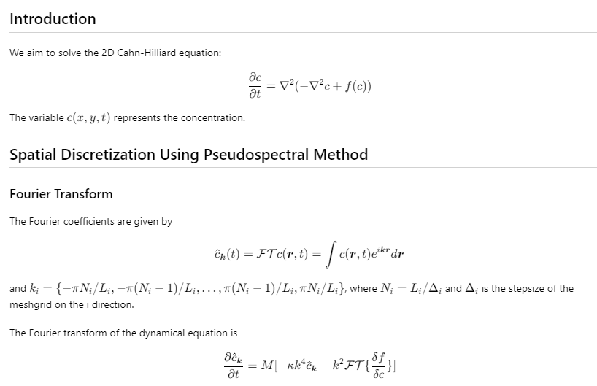

Slide 3
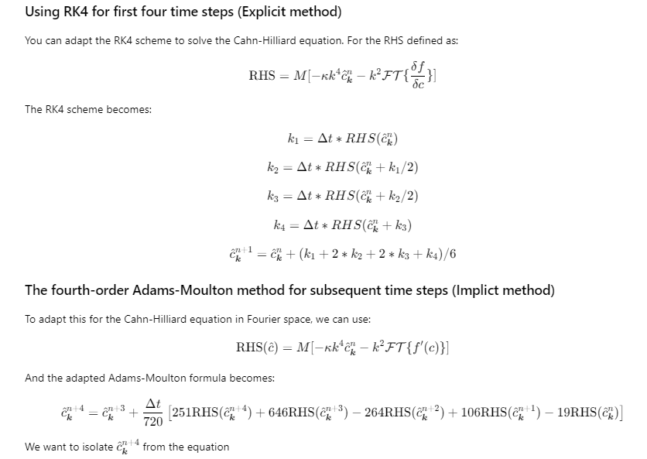

Slide 4
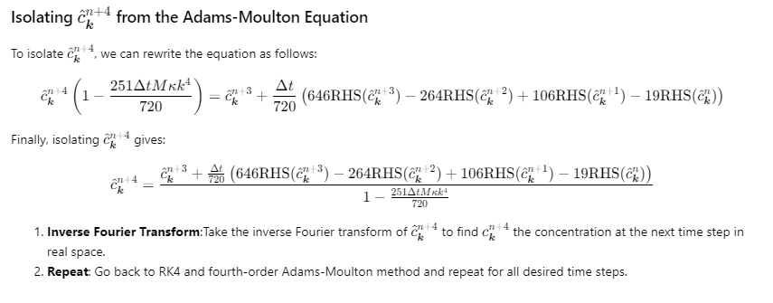

Slide 5
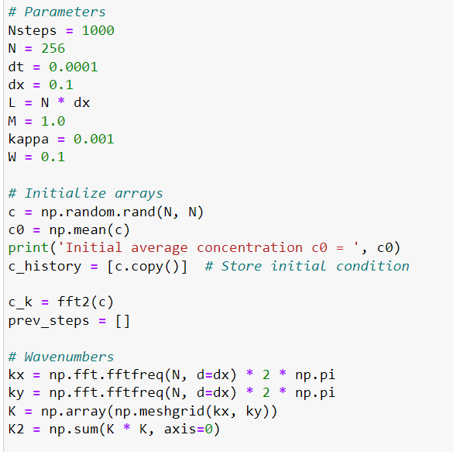
Initial conditions and parameters

Slide 6
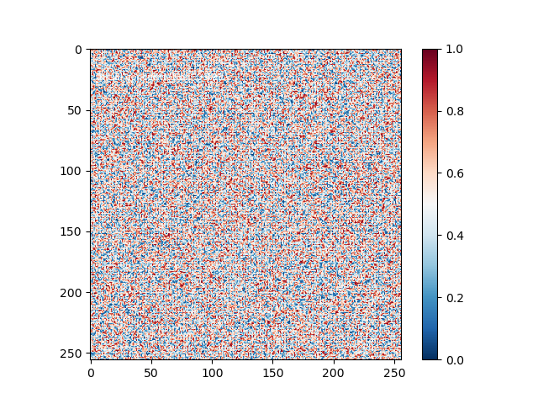
Results

Slide 7
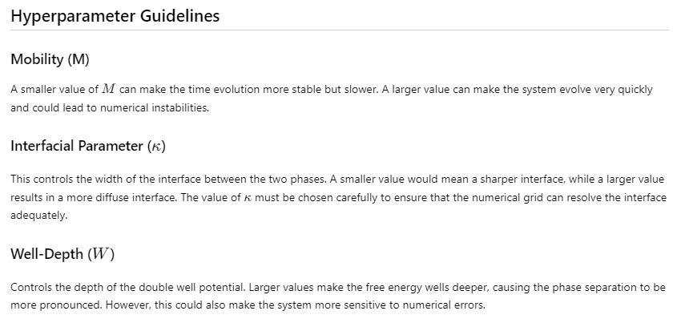

Slide 8
